Slide 1



Mentorness
Pizza
Sales
Analysis
By - Harsh Kumar Sahu

Slide 2

Objective
The goal of this SQL project is to analyze pizza sales data to gain insights into customer behavior, popular pizza types, sales trends, and over all performance.

Slide 3

Datasets
The analysis will be performed using four tables:
order_details
orders
pizza_type
pizza.

Slide 4
order_details
2. order
• order_details_id: Unique identifier for the order detail.
• order_id: Identifier linking to the orders table.
• pizza_id: Identifier linking to the pizza table.
• quantity: Number of pizzas ordered.
• order_id: Unique identifier for the order.
• date: Date the order was placed.
• time: Time the order was placed.

Slide 5
3. pizza_type
4. pizza
• pizza_type_id: Unique identifier for the pizza type.
• name: Name of the pizza.
• category: Category of the pizza (e.g., vegetarian, meat, etc.).
• ingredients: List of ingredients used in the pizza.
• pizza_id: Unique identifier for the pizza.
• pizza_type_id: Identifier linking to the pizza_type table.
• size: Size of the pizza (e.g., small, medium, large).
• price: Price of the pizza.

Slide 6
Questions.
Q1: The total number of order place
Q2: The total revenue generated from pizza sales
Q3: The highest priced pizza.
Q4: The most common pizza size ordered.
Q5: The top 5 most ordered pizza types along their quantities.
Q6: The quantity of each pizza categories ordered.
Q7: The distribution of orders by hours of the day.
Q8: The category-wise distribution of pizzas.
Q9: The average number of pizzas ordered per day.
Q10: Top 3 most ordered pizza type base on revenue.
Q11: The percentage contribution of each pizza type to revenue.
Q12: The cumulative revenue generated over time.
Q13: The top 3 most ordered pizza type based on revenue for each pizza category.

Slide 7
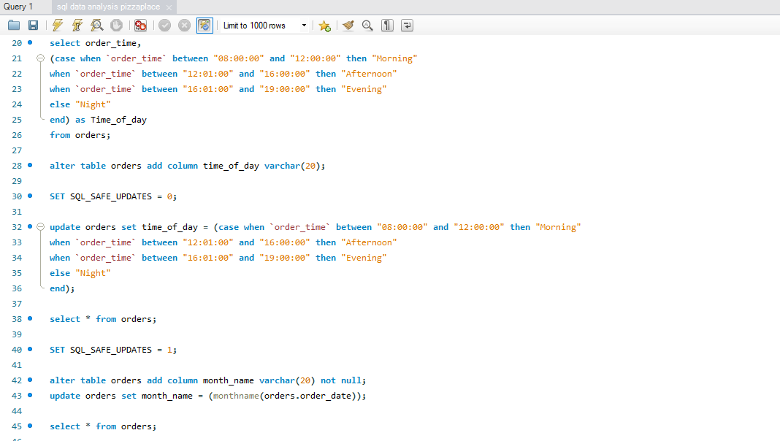

Slide 8
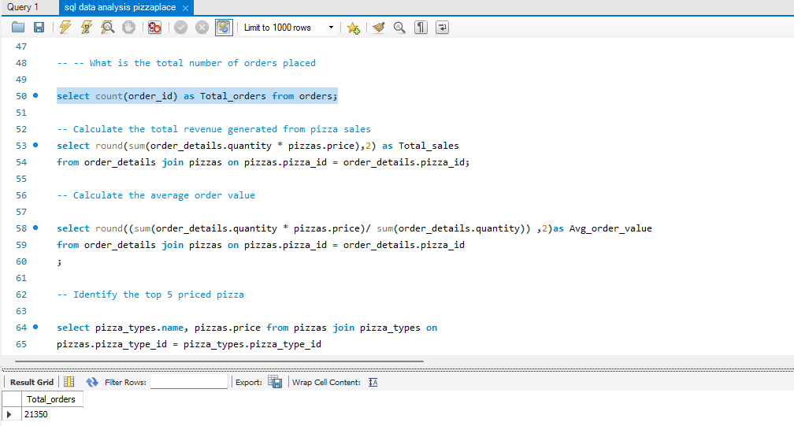

Slide 9
THANKYOU

